Slide 1
“Blackboard Ate My Homework!”
Chris Bray
Blackboard Administrator
University of Arkansas

Slide 2
About me
Chris Bray
Blackboard Administrator
University of Arkansas
cbray@uark.edu http://bbadmin.uark.edu @zenandjuice
LMS Administrator since 1997

Slide 3
About my institution
University of Arkansas in Fayetteville, AR
23,286 total students in Spring 2013
Blackboard Usage
2,946 courses
20,944 students
76,294 enrollments
1,164 course instructors

Slide 4
What we are going to learn today
Students (and even instructors) report that Blackboard Learn "ate their homework”.
Using the access logs and user activity reports, the system administrator can see what a user REALLY did.
In this session, we'll look at what forensic data and tools are needed to investigate, including tomcat logs, reporting tools, and SQL queries.

Slide 5
OUR challenge
Students often tell their instructors that they submitted something in Blackboard Learn, but the system says otherwise.
Some instructors believe them and give the student another chance to submit, but many believe that the student is trying to pull a fast one.
How can we track down what a user did (not) do, and find out the truth?

Slide 6
Our Solution
Collect the data
Analyze the data
Report the findings

Slide 7
Data Collection

Slide 8
Data Collection
Logs and logging best practices
Student and Course information
User Activity Report
Test Access Logs (SP13)
Grade History
Authentication logs
Tomcat Access Logs – user specific lines

Slide 9
Logs and Locations
Most logs are stored in the <blackboard_install_directory>/logs directory.
Several types of logs
Blackboard
Web Server (httpd/)
Tomcat (tomcat/bb-access-log…)
Logs can also be managed and viewed from the Logs link on the System Admin Tab in the user interface.

Slide 10
Logging Best Practices
Archive, never delete, log files
Compress old ones to save space!
Uncompressed Fall 2012 tomcat access logs = 115 GB
Compressed = 9.8 GB (gzip -9)
For analysis, I keep copies elsewhere, using UNIX commands for searching (or Splunk).

Slide 11
Common Requests
Did the student login when they say they did?
Did the student submit a SafeAssignment?
Did the student attempt a test?
Did the student submit an Assignment?
Did they access Discussions (Wikis/Blogs/Journals)?
Did my instructor change my grades?

Slide 12
Evernote template
Student Name:
Student Username:
Student pk1:
Date Range:
Course Name:
Course ID:
course pk1:
Instructor Name:
Assignment/Test Name
Location:
content url:
content_id:
Creation Date:
Last Modified Date:
Due Date:

Slide 13
Determining user pk1
select users.pk1 from users where user_id LIKE ’[username]’;
Using SQLPLUS, SQLDeveloper, etc
15:04:47 SQL> select user_id, pk1 from users where pk1 LIKE '&username';
Enter value for username: cbray
old 1: select user_id, pk1 from users where pk1 LIKE '&username'
new 1: select user_id, pk1 from users where pk1 LIKE 'cbray'

Slide 14
Determining course pk1
“Easy way” – look in the course URL,
https://learn.uark.edu/webapps/portal/frameset.jsp?tab_tab_group_id=_2_1&url=%2Fwebapps%2Fblackboard%2Fexecute%2Flauncher%3Ftype%3DCourse%26id%3D_1844_1%26url%3D
Or the Database Method: SQL> select pk1 from course_main where course_id LIKE '1119-THEUA-KINS-2303-SEC012-1731';
PK1 1844

Slide 15
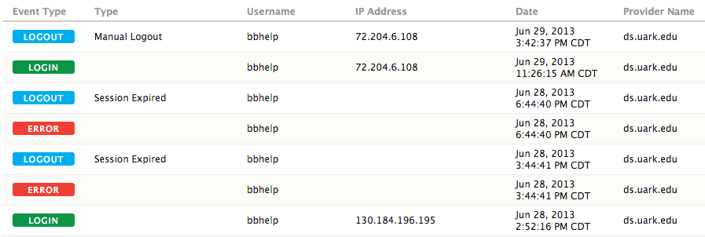
Authentication Logs
When did they login? When did they logout?

Slide 16
Authentication Logs

Slide 17
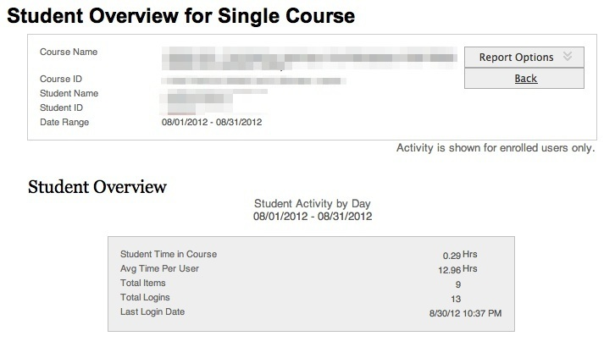
User Activity Report

Slide 18
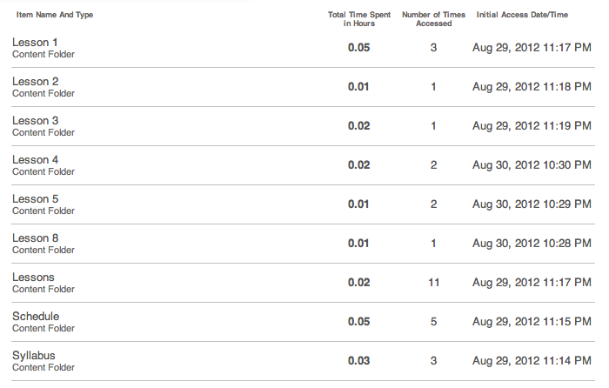
User Activity Report

Slide 19
User Activity Report

Slide 20
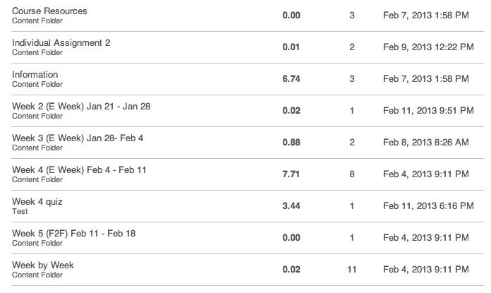
User Activity Report

Slide 21
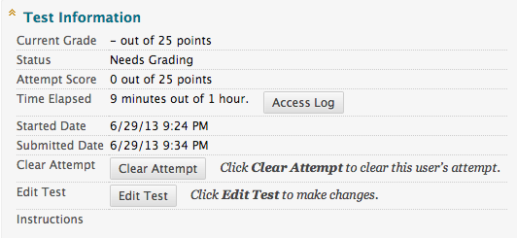
Test Access Logs

Slide 22
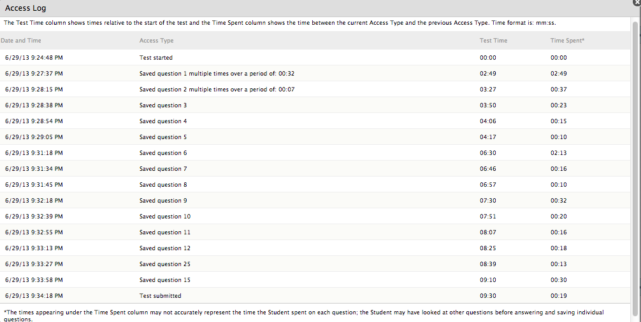
Test Access Logs

Slide 23
Test Access LogS

Slide 24
Grade History
[default = instructors can clear this. Change that!]
Record of who did what to a gradable item/column
Did student even try the test?
Did instructor accidently clear all attempts?
Did instructor change the grade?

Slide 25
Tomcat Access Logs
Collect all server tomcat logs in one hierarchy
app01/ app02/ app03/ app04/
Searching
grep –h _[pk1] app0?/tomcat/bb-access-log* >> username.log
grep –h _[pk1] app0?/tomcat/bb-access-log.2013-03-0[6-9]*
zgrep _[pk1] app0?/tomcat/bb-access-log*.gz >> username.log

Slide 26
Data Analysis

Slide 27
What are we looking for?
Accesses on specific day/time
Did they enter the course?
Did they enter a Content Area?
Use a Building Block based tool?

Slide 28
Base Line Comparison
Find a student who did complete the task
Grab their log data, and search for the appropriate keywords
Clean up sensitive information, and include this in your report.

Slide 29
Analyze & Annotate
Does User Activity Log show any valuable references?
If not, search logs for keywords/content ids
Carefully go through the logs
Paste into text editor
Commenting and Markup
Highlight
Annotate and describe their actions

Slide 30
Common Application Log References
mdb = SafeAssign
assessment = test
uploadAssignment = assignments
InstanceNotFound = third-party cookies not set
courseTocLabel = course menu
discussionboard = discussions
listContent = student page listing
listContentEditable = instructor page listing

Slide 31
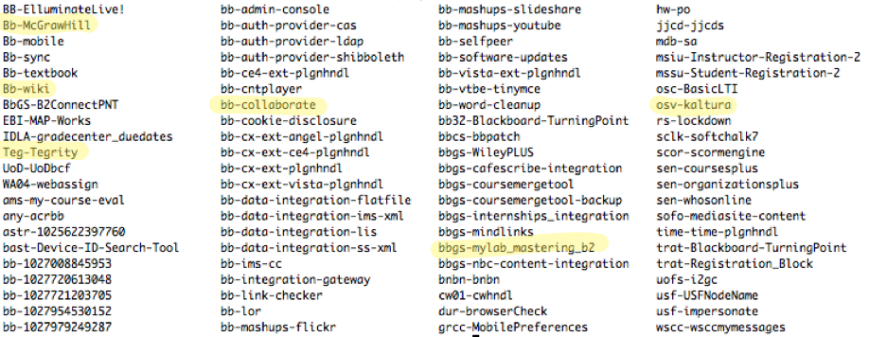
Common Building Block References

Slide 32
Report

Slide 33
Summary of Findings
Original Request Text
“Quick Summary”
Collected Forensic Data with annotations
Base-Line Comparison Data

Slide 34
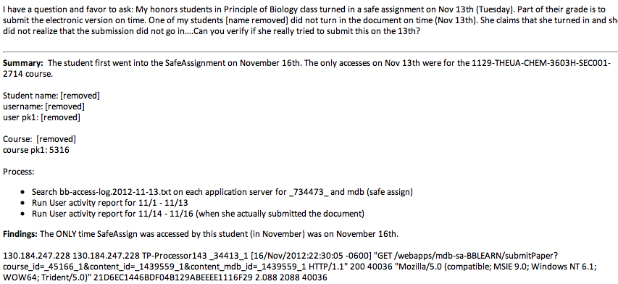
Example Report

Slide 35
Who Gets the Report
Student Request? Send to them and instructor
Instructor request? Send to instructor
Judicial Affairs [eek]
Department head and Deans

Slide 36
Examples

Slide 37
Examples
SafeAssign
Assignment
Discussions
Tests
“Blackboard gave me the wrong data file”

Slide 38
Snow Day Crash
I was awoken early (school had a 10 a.m. start time due to snow) by Data Center staff because Blackboard was non-responsive.
This occurred between 8:00 - 8:03 am, and this one account was having around 1000 hits to 2500 hits per minute to the system.
This caused a massive database increase, which slowed the system down substantially.

Slide 39
Tomcat says…
At 8:00 am a user did what they refer to as an "F5 refresh attack", where they held down the refresh key in their browser, leading to repeated refreshes of the site.
5,500 accesses to a Geology course module page:
[21/Feb/2013:07:59:29 -0600] "GET /webapps/blackboard/execute/modulepage/view?course_id=_49409_1&cmp_tab_id=_94015_1&mode=view HTTP/1.1" 200 59794 "Mozilla/5.0 (Windows NT 6.1; WOW64) AppleWebKit/537.17 (KHTML, like Gecko) Chrome/24.0.1312.57 Safari/537.17”

Slide 40
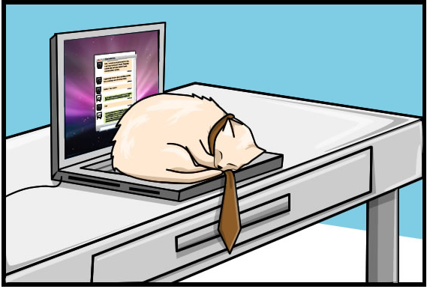
Theory #1 (A different tomcat)

Slide 41
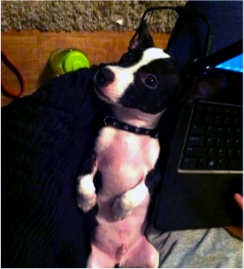
Thanks to Google and twitter…

Slide 42
Email to Student
This is going to sound really odd.
There was an incident yesterday (Thursday) morning, Blackboard slowed to a crawl, and we tracked the problem down to activity in your account.
You're not in any trouble, so don't worry. I'm just trying to track down a series of events, and I'm hoping you can help.

Slide 43
Email to Student
I did some Googling, and it looks like around 8:15 am yesterday, you tweeted that Milo ate your headphones.
Is Milo, @[twitter handle removed] ?
And does Milo ever plop down on your computer's keyboard? In particular, around 8:01 am yesterday.
Or was there another incident where something landed on your computer keyboard at that time yesterday morning?

Slide 44
Timeline
Student wakes up around 5 a.m. to start studying for two big tests since school was not cancelled.
She logs into Blackboard Learn at 5:23 a.m. and stays logged in.
Milo steps on her laptop at some point, and she corrects him.
Just before 8 a.m., she pauses studying and leaves the room.

Slide 45
Timeline
8:01 a.m., Milo steps on the keyboard, pressing the F5 key for awhile, causing the DDOS (Doggy Denial of Service).
Milo moves off the keyboard, and chews up her headphones.
She tweeted about the headphones at 8:15 am.
Her login session timed out at 12:01pm, 3 hours (normal duration) after the incident.

Slide 46
Later on twitter…

Slide 47
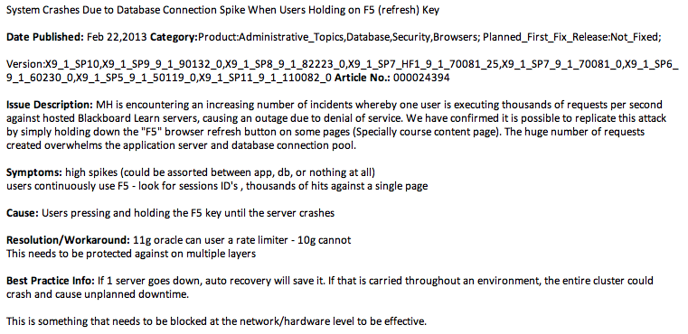
Behind the Blackboard says…

Slide 48
Resources
help.blackboard.com
Blackboard Server Administration Guide
Help for Administrators > System Management > Logs
Understanding Blackboard Error Logs by Matthew Saltzman (recording at devcon2012.coursesites.com)
Tracking User Activity in the Webserver Logs (BtBbArticle # 000014571)

Slide 49
Resources
BBADMIN-L (http://is.asu.edu/instruction/faq/usingBBADMIN-L.html)
BLKBRD-L (http://is.asu.edu/instruction/faq/usingBLKBRD-L.html)
TechBUG

Slide 50
Thank you!
Chris Bray
Blackboard Administrator
University of Arkansas
cbray@uark.edu http://bbadmin.uark.edu @zenandjuice
If you would like to provide feedback for this session please email: BbWorldFeedback@blackboard.com
The title of this session is: Blackboard Ate My Homework

